Slide 1
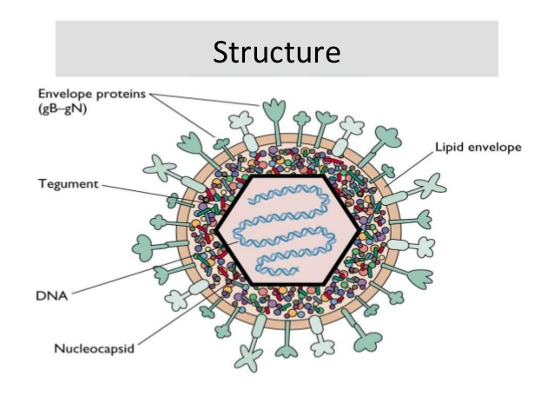
herpes
Name of pathogen –
Herpes is an infection caused by
HSV ( Herpes Simplex Virus)
Two types of Herpes virus –
HSV 1
HSV 2

Slide 2
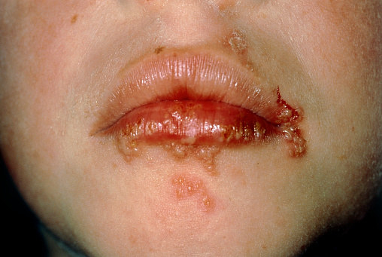
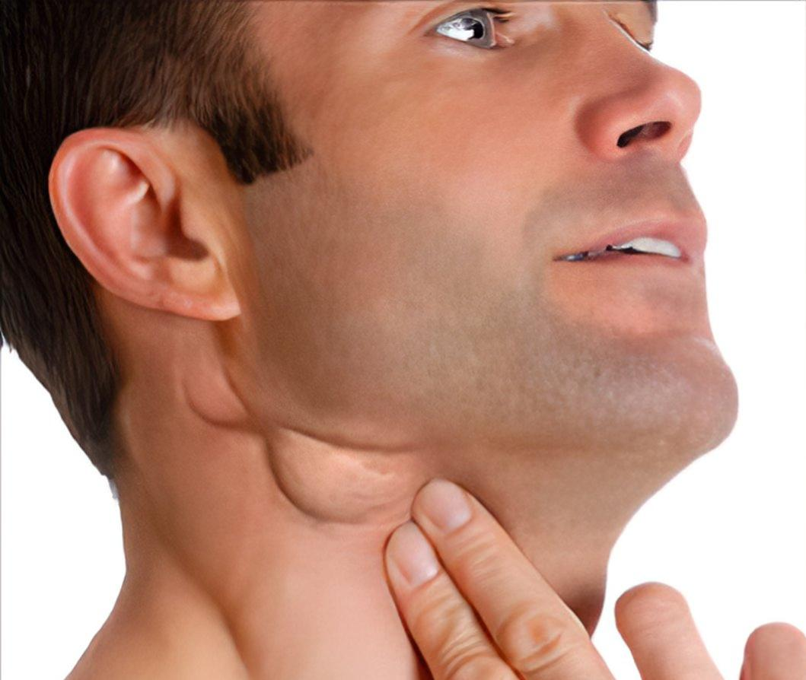
Symptoms -
Blistering sores
Pain during urination
Itching
Fever
Swollen lymph nodes
Tiredness
Lack of appetite
Headache

Slide 3
PATHOGENESIS
HSV
Establishes the primary infection within the host
Enters sensory nerve terminals at peripheral sites
Enters the trigeminal nerve ganglion
Establishes latency
Reaction of virus
Reaches the epidermis and at the epidermal junction
Results in recurrent infection

Slide 4
Mode of action
The surface glycoproteins of HSV are evolutionary conserved.
It shows an extra-ordinary ability to bind more than one receptor on the host cell surface.
It's lipid envelope with the host cell membrane and therefore releases its nucleocapsid along with tegument proteins into the cytosol.
HSV has the ability to enter into the host cells by direct fusion with the plasma membrane or via endocytic pathways. The latter can be pH dependent or independent.

Slide 5
prevention
Take herpes medication.
Don't have sex during a herpes outbreaks even with a condom.
Vaccination for the prevention of herpes
People with genital herpes should use condoms at all times.

Slide 6
.
Thank you

