Slide 1
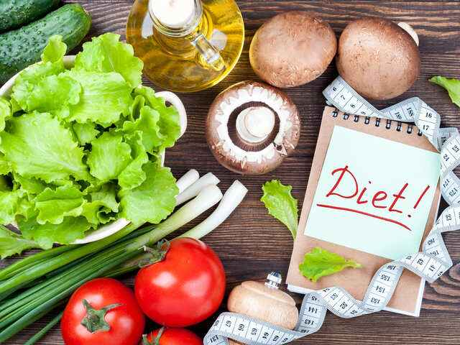
DIET
Diet is the sum of food consumed by a person or other organism
Diet can also refer to the food and drink a person consumes daily and the mental and physical circumstances connected to eating.

Slide 2
BALANCED DIET
A balanced diet is a diet that contains differing kinds of foods in certain quantities and proportions so that the requirement for calories, proteins, minerals, vitamins and alternative nutrients is adequate to maintain health.
The quantities of foods needed to meet the nutrient requirements vary with age, gender, physiological status and physical activity.
A balanced diet should provide around 50-60% of total calories from carbohydrates, preferably from complex carbohydrates, about 10-15% from proteins and 20-30% from both visible and invisible fat.

Slide 3
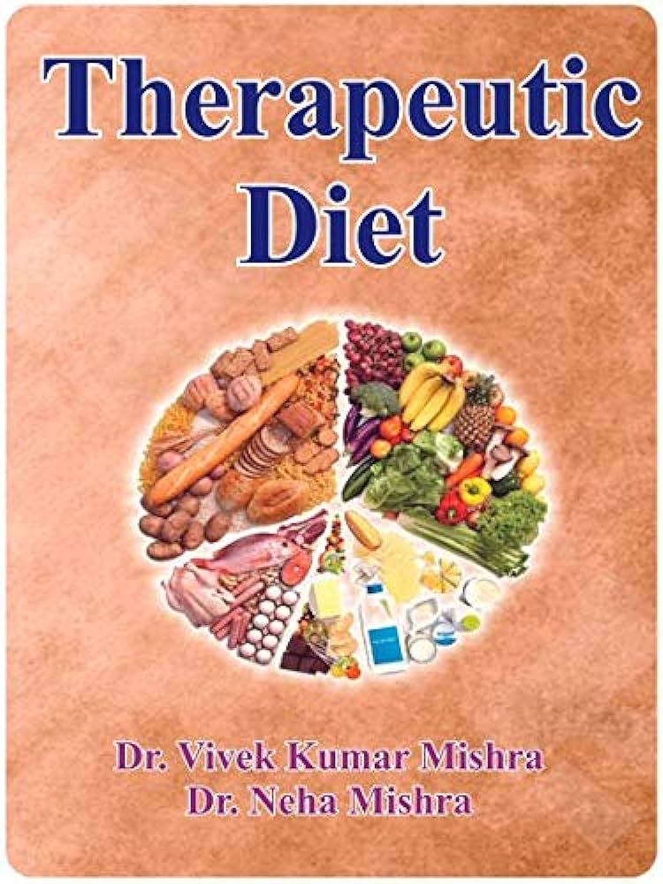
THERAPEUTIC DIET
A therapeutic diet is a meal plan that controls the intake of certain foods or nutrients. It is part of the treatment of a medical condition and are normally prescribed by a physician and planned by a dietician. A therapeutic diet is usually a modification of a regular diet. In therapeutics diets, modifications are done in nutrients, texture and food allergies or food intolerances.

Slide 4
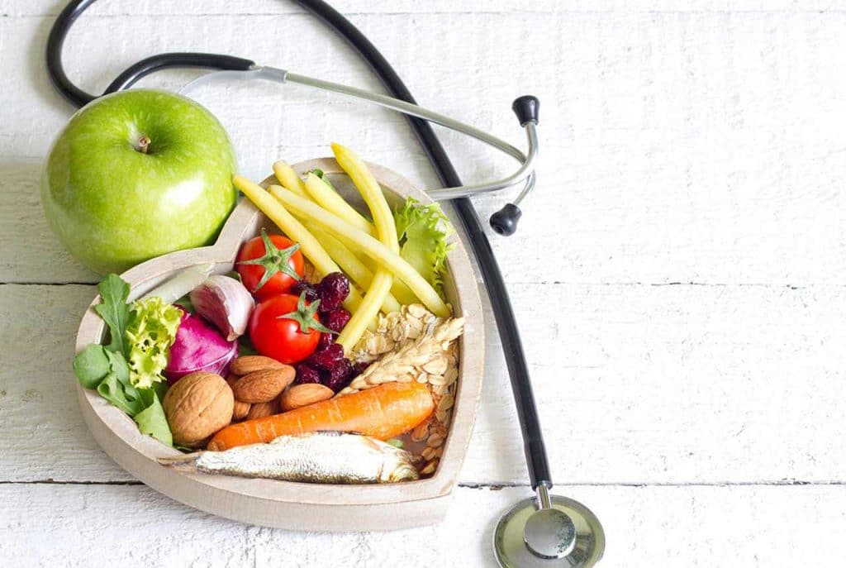
DIET THERAPY
Diet therapy means the use of diet (food & drink) not only in the care of the sick, but also in the prevention of disease & the maintenance of the health.

Slide 5
PRINCIPLES OF DIET THERAPY
The principles of diet therapy are to:
maintain good nutritional status,
correct deficiencies or disease, if any,
provide rest to the body,
help metabolize the nutrients, and
make changes in body weight, when necessary

Slide 6
FACTORS TO BE CONSIDERED IN PLANNING THERAPEUTIC DIETS
The normal diet may be modified:
a. To provide change in consistency as in fluid and soft diet
b. To increase or decrease the energy needs
c. To increase or decrease one or more amounts of nutrients, e.g. in case of high protein diets or sodium and potassium restricted diets, restricted fat diet, etc.
d. To increase or decrease bulk [high or low fibre] diets
e. To include or exclude certain allergic foods
f. To modify the intervals of feeds [like in tube feeds etc]

Slide 7
BASIC PRINCIPLE OF DIET THERAPY
Before prescribing the diet, one should collect information on -
(a) Socioeconomic history,
(b) Medical history, and
(c) Dietary history.

Slide 8
SOCIOECONOMIC HISTORY:
Occupation — Type of job, Time spent at work place, Travel item to & frame of the work place, Family relationship.
Residence — Own/Rented.
Extracurricular activity.
Religious belief regarding food.

Slide 9
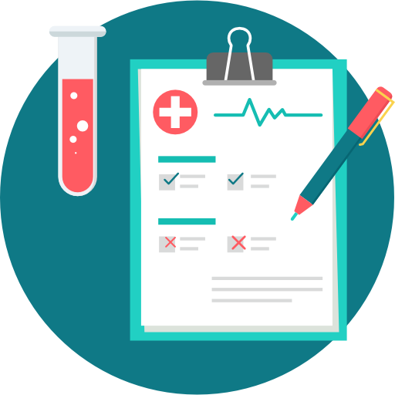
MEDICAL HISTORY:
Present illness, Weight, Appetite, Digestion, Elimination, Handicap pertaining to feeding.
Drugs taking/ taken.

Slide 10
DIETARY HISTORY:
Meals — Where eaten, when, with whom.
Meals skipped — Which, How often.
Food preparation — By whom and the facilities available.
Meals away from home – Canteen, Cafeteria, restaurant school lunch etc.
Snacks – How often, type, quantity food likes and Dislike.

Slide 11
CLASSIFICATION OF MODIFIED DIET
MODIFIED DIETS
CONSISTENCY
1. Clear liquid
2. Full liquid
3. Soft diet
4. Mechanical soft diet
5.Bland diet
6. Normal diet
NUTRIENT CONTENT
1. High fiber
2. Low protein
3. Na restricted
4. Low fat
5. Low fiber
QUANTITY
1. Obesity
2. CVD
3. Diarrhea
4. Diabetes
SPECIAL METHD OF FEEDING
1. Enteral
( tube feeding)
2. Parenteral
(intravenous fluid)

Slide 12
MODIFICATIONS IN CONSISTENCY

Slide 13
NORMAL DIET-
A normal diet is defined as one which consist of any and all food eaten by the person in health.
It is planned keeping the basic food groups in mind so that optimum amounts of all nutrients provided.
Since the patient is hospitalized or at bed rest, a reduction of 10% in energy intake should be made.

Slide 14
FLUID DIETS
Fluid diets are used in febrile states, post-operatively or whenever the patient is unable to tolerate solid foods.
Fluid diet are of two types depending upon nutritional adequacy-
Clear fluid diet
Full fluid diet

Slide 15
CLEAR FLUID DIET-
CONSIST OF ONLY CLEAR FLUIDS.
The diet is free from any solids, even those found in milk.
The clear fluid diet is inadequate in all nutrients & use only for 1-2 days.
PURPOSE- to prevent dehydration and relieve thirst.
USED FOR- short periods such as in acute vomiting or diarrhea.
High in simple sugars & need to be modified for diabetic patients.
AMOUNT OF FLUID GIVEN- initially 40-80ml/hour, which is than gradually increased to 100-120 ml/day.
FOODS INCLUDED:-
Fruit juices- apple, orange grape
Cereal water- barley, arrowroot water, sago kanji, rice kanji
Soups- clear soups, fat free
Beverages- tea, coffee with lime & sugar (no milk), lime juice, coconut water, sugarcane juice
Flavored gelatin and fruit ices

Slide 16
FULL FLUID DIET
PRESCRIBED TO- individuals who are unable to chew, swallow or tolerate solid foods.
GIVEN- after clear fluid & before starting solid diet.
Composed of foods that are liquid at room temperature.
It is free from cellulose & irritating condiments or spices.
It is well planned to meet most of the RDA’s .
PRESCRIBED DURING- acute infections, gastritis, after surgery, & for people too ill to eat solid food..
Diet provide- approx. 1500-2000 kal, 55-65g protein and adequate minerals and vitamins
FOODS INCLUDED-
Cream soups, daal soup, whipped potatoes.
Milk shakes, plain ice cream, custard.
Oat meal, arrowroot, & sago kanji with milk.
Soyamilk, complain, lassi

Slide 17
SOFT DIET
FOODS INCLUDED-
Refined cereals
Washed pulses- form of soups & in combination of cereals & vegetables.
Milk & milk products.
Eggs & lean meats.
Soft fruits like papaya, banana, mango etc.
Fats like butter, cream vegetable oils.
Salt & sugar in moderation.
FOODS RESTRICTED-
Spicy, highly seasoned & fried foods are avoided.
Raw vegetables & fruits.
Whole grain cereals &their products.
Dried fruits & nuts.
Soft diet is nutritionally adequate diet.
It is soft in consistency & easy to chew.
Made up of simple, easily digested foods
It is moderately low in cellulose.
Prescribed in- conditions where mechanical ease in eating or digestion both are desired.
Given during- acute infections , GI disorders , & after surgery.
SOFT DIET SUPPLIES- 1800-2000 kcal, 55-65g protein.

Slide 18
SOFT DIET
MECHANICAL SOFT DIET
Also called as dental diet.
It includes foods which are easy to chew & swallow.
No restriction on seasoning or method of preparation.
Food may be modified by-
mechanical processing Such as mashing, blendrizing, or chopping.
LIGHT DIET OR GENERAL HOSPITAL DIET-
Similar to the soft diet.
Also includes –
simple salads,
fruit salads, &
paneer.

Slide 19
BLAND DIET
FOODS INCLUDED-
Milk & milk products.
Refined cereals & rice.
Cream, butter
Cooked fruits & vegetables without peel & seed.
All egg preparations except omelet's & fried eggs.
FOODS AVOIDED-
Strong tea, coffee, alcoholic beverages, condiments & spices.
High fiber foods & hot soups & beverages.
Fried foods.
PRESCRIBED FOR-
Individuals suffering from gastric or duodenal ulcers, gastritis, & ulcerative colitis.
INCLUDES-
Foods which are mechanically, chemically & thermally non irritating , foods low in fiber are recommended.

Slide 20
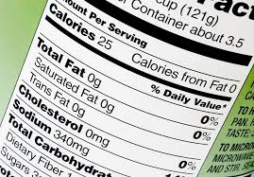
MODIFICATIONS IN NUTRIENT CONTENT
The nutrient content of the diet is modified to treat deficiencies, change body weight, or control diseases such as hypertension & diabetes.
Fiber, sodium and fat content are modified in some conditions.

Slide 21
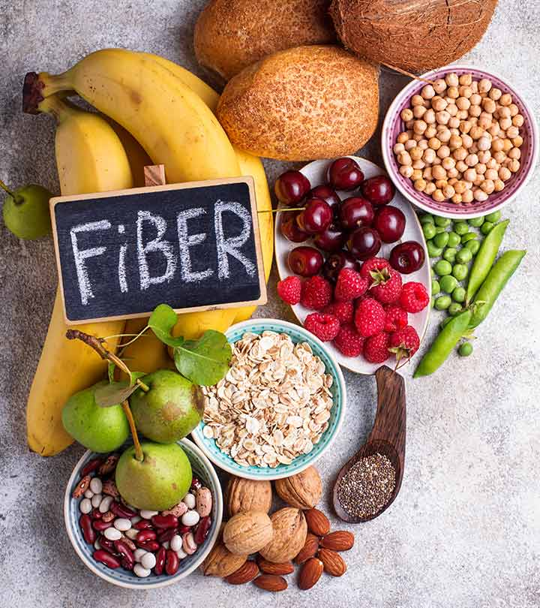
MODOFICATION IN FIBER-
Bulk & fiber has been used for all indigestible polysaccharides which remains after digestion of food.
Fiber can be modified in two ways-
LOW FIBER DIET-
PRESCRIBED DURING - acute infections of the GI tract.
such as ulcerative colitis, severe diarrhea.
HIGH FIBER DIET-
USED TO- prevent & treat constipation.
Also prescribed in obesity to increase the volume of food..

Slide 22
High Calorie , High Protein diet
High calorie needs are based on several factors, including:
Gender. Women generally burn 5–10% fewer calories at rest than men of the same height
Age. The number of calories you burn at rest declines with age
Height. The taller you are, the more calories you need to maintain your weight.
Activity. Exercise and activities like yard work and fidgeting increase calorie needs
FOOD RECOMMENDED | FOOD TO BE AVOIDED
All foods should be liquid to semi solid consistency. Smooth texture with no harsh irritating fibers , strong flavors or spicy foods. | Solid foods which are hard or tough , requiring lot of mastication .
1 Cereals- Refined cereals in the form of kanji ,custard , kheer , phulka, boiled rice . | 1 Cereals- Millets , cereal or irritating dietary fibers such as whole grain cereals and cereal products .
2 Good quality , easy to digest proteins , chicken soups, milk based beverages , strew , Egg nob , sweet freshly set custards, complain ,soft cooked khichdi, custard ,boiled vegetables such as pumpkin ,bottle gourd, potato. Strewed fruits, soft fruits , fruit juices, sugar. | 2 Fried , spicy pulse and meat – fish – poultry preparations . Leafy vegetables , raw fruits , and vegetables with harsh fibers Pickles, papad .
High protein diet: A high protein diet is a type of weight loss plan that emphasizes consumption of high-protein-containing foods. There are many different kinds of high protein diets like Atkins diet.

Slide 23
Low-Protein Diet
Low-protein foods | Moderate-protein foods
All fruits, except dried fruits All vegetables, except peas, beans, and corn Many sources of healthful fats, such as olive oil and avocados Herbs and spices | bread crackers breakfast cereals pasta oats corn rice
A low-protein diet puts less strain on the kidneys. As a result, this type of diet can benefit people with kidney-related disorders, such as kidney disease or phenylketonuria

Slide 24
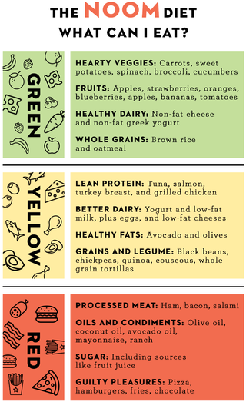
LOW-FAT DIET
A low-fat diet is one that restricts fat, and often saturated fat and cholesterol as well. Low-fat diets are intended to reduce the occurrence of conditions such as heart disease and obesity.

Slide 25
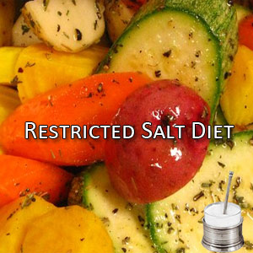
Sodium Restricted Diet
Foods recommended | Foods to be avoided
Foods low in sodium | Food rich in cholesterol and fat, food rich in sodium
1. cereals- wheat, rice, oatmeal, millets | 1. Baking power- cake ,cookies
2.All fruits- fresh and canned | 2. Soda bicarbonate- nankhatai
3. Cabbage, cauliflower, tomato , potato onion . | 3. Monosodium glutamate- Chinese foods and food served in restaurant.
4. sugar, honey, jam, jelly. | 4.Sodium benzoate- tomato sauce
5. Low sodium seasonings instead of salt. | 5. Sodium propionate- bread
6. Lime juice. | 6.Sodium chloride- salted shanks, wafers, nuts.
7. Mint, parsley, dill, basil. | 7.Papad, pickles, vegetables in brine solution.
8. Fresh vegetables. | 8. Celery , beetroot and spinach.
9. All other vegetables, root vegetables. | 9. Foods rich in cholesterol and saturated fats- salted butter and processed cheese.
10. Vegetables oil as a cooking medium.
11. Milk in moderation.
A low-sodium diet is commonly prescribed to people with certain medical conditions, including heart failure, high blood pressure and kidney disease.
Sodium is an essential mineral involved in many important bodily functions, including cellular function, fluid regulation, electrolyte balance and maintaining blood pressure

Slide 26
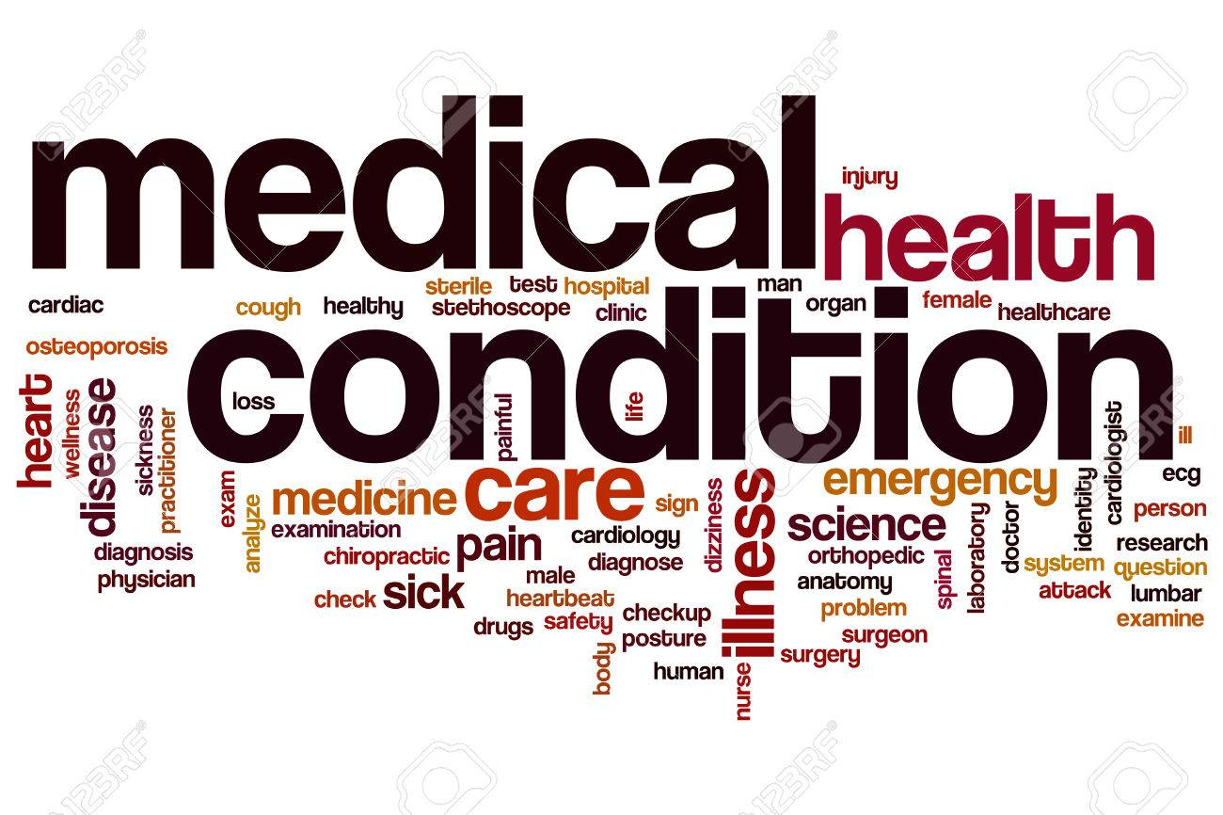
QUANTITY/ MODIFICATION IN DISEASES CONDITION

Slide 27
MODIFICATONS IN QUANTITY
The quantity of food served to the patient needs to be modified:-
to check tolerance,
control nutrient levels, &
bring about weight loss.
Example- in a diabetic diet, the quantity of CHO in each meal is as important as the quantity of CHO consumed in a day

Slide 28
DIETS FOR COMMON DISORDERS

Slide 29
Diet for Diabetes mellitus patients
It is important to eat every 4 to 6 hours to keep your blood sugar levels stable. Try to have three daily meals at regular times and have healthy snacks when you are hungry. A balanced meal has foods that include plenty of vegetables and fruits, high protein foods and whole grains.
Foods recommended | Foods to be avoided
Complex carbohydrates rich in dietary fiber- millets , wheat, pasta, bread. | 1. Simple sugar and refined carbohydrates sugars, jaggery, sweets.
2.Higher proportion of PUFA vegetable oils. | 2. Saturated fats and cholesterol in moderation hydrogenated fats ,ghee, butter, cream.
3. Good quality proteins- Lean meat, fish, eggs, pulses, milk. | 3. Alcohol, soft drinks, sweet meats , nuts and oil seeds.
4.Salads, leafy vegetables ,other vegetables.

Slide 30
Diet for Heart Disease
Eat larger portions of low-calorie, nutrient-rich foods, such as fruits and vegetables, and smaller portions of high-calorie, high-sodium foods, such as refined, processed or fast foods. This strategy can shape up your diet as well as your heart and waistline
Personal factors | Diet pattern | Other diseases
Heredity or strong family history. | Alcoholic | Hypertension
Males\Females after menopause | Consumes rich foods | Atherosclerosis
Smoking | High in fats and cholesterol | Diabetes
Obesity | Low in fiber | Obesity
Age group 35-55 yrs | Refined CHO and sugars | High blood lipid levels
Work load- Tension and stress | High salt intake
Sedentary life style
EATING MORE
fruits and vegetables,
low-fat or non fat dairy,
beans, and
nuts.
EATING LESS
fatty meats,
full-fat dairy products,
sugar-sweetened beverages,
sweets, and
sodium (salt).

Slide 31
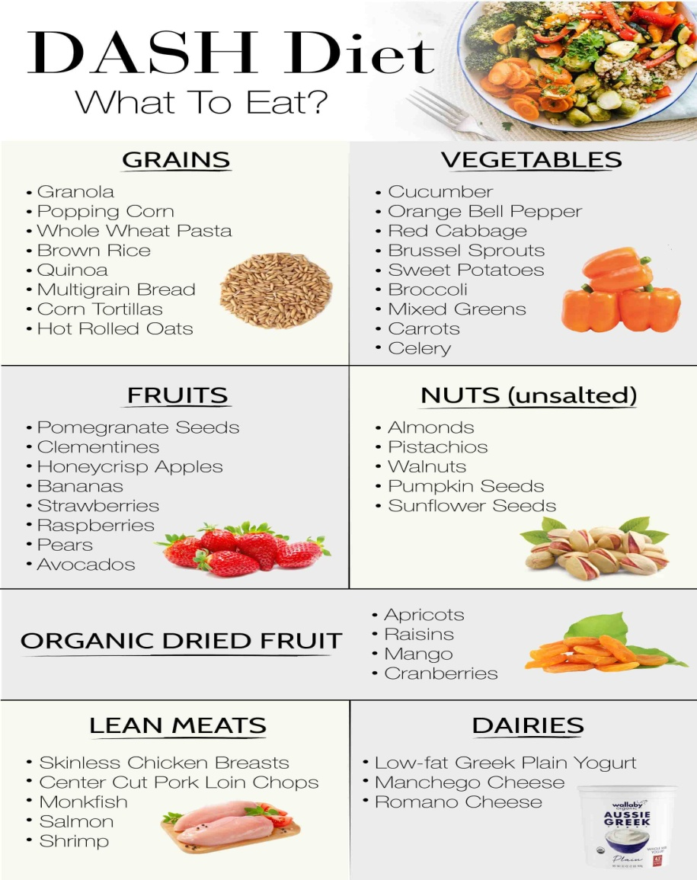
Modified diet in Hypertension
DASH DIET-
DASH stands for Dietary Approaches to Stop Hypertension. The diet is simple:
Eat more fruits, vegetables, and low-fat dairy foods
Cut back on foods that are high in saturated fat, cholesterol, and trans fats
Eat more whole-grain foods, fish, poultry, and nuts
Limit sodium, sweets, sugary drinks, and red meats

Slide 32
DISEASES WITH NUTRIENT MODIFICATION
DISEASE | NUTIENT MODIFICATION
Atherosclerosis | F at controlled, low cholesterol diet
Hepatitis | Restricted fat diets
Anemia, High fever, Injury | High protein diet
Hypertension, Cardiovascular disease | Sodium restricted diet
Lactose intolerance | Lactose free diet
Hepatic coma | Low protein diet
Underweight, Malnutrition | High calorie diet

Slide 33
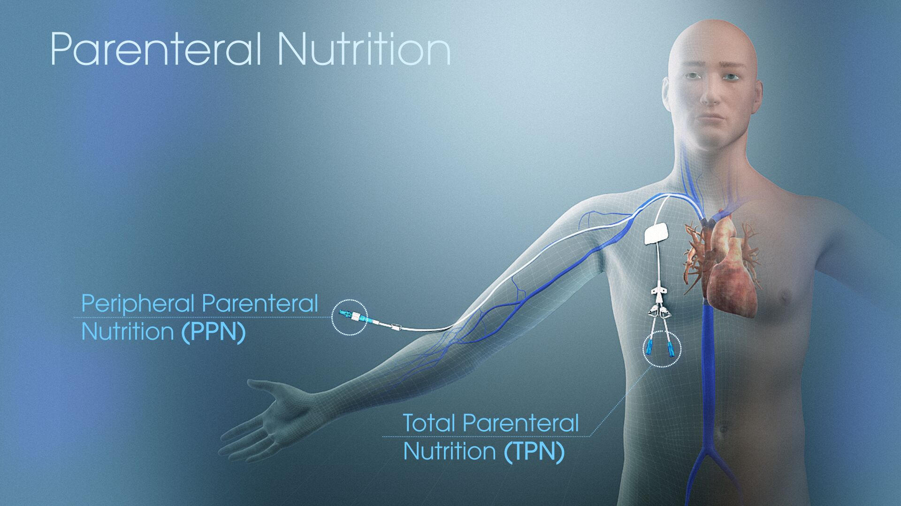
MODIFICATIONS IN METHOD OF FEEDING

Slide 34
MODIFICATIONS IN METHOD OF FEEDING
Enteral feeding- EN is provision of liquid formula diet delivered via a feeding tube is the method for patients with a functional GI tract who requires NS.
Enteral feeding is required when oral feeding is not possible.
Parenteral feeding- parenteral fluids contain water, glucose, amino acids, fatty acids, minerals, & vitamins to meet the individual need for all nutrients.
These fluids are given through the peripheral & central veins.

Slide 35
What is Enteral Feeding?
Enteral feeding refers to intake of food via the gastrointestinal (GI) tract. The GI tract is composed of the mouth, esophagus, stomach, and intestines.
Enteral feeding may mean nutrition taken through the mouth or through a tube that goes directly to the stomach or small intestine. In the medical setting, the term enteral feeding is most often used to mean tube feeding.
A person on enteral feeds usually has a condition or injury that prevents eating a regular diet by mouth, but their GI tract is still able to function.
When is Enteral feeding used?
Tube feedings may become necessary when you can’t eat enough calories to meet your nutritional needs. This may occur if you physically can’t eat, can’t eat safely, or if your caloric requirements are increased beyond your ability to eat.
Enteral feeding include:
a stroke, which may impair ability to swallow
cancer, which may cause fatigue, nausea, and vomiting that make it difficult to eat
critical illness or injury, which reduces energy or ability to eat
failure to thrive or inability to eat in young children or infants
serious illness, which places the body in a state of stress, making it difficult to take in enough nutrients
neurological or movement disorders that increase caloric requirements while making it more difficult to eat
GI dysfunction or disease, although this may require intravenous (IV) nutrition instead

Slide 36
Types Of Enteral Feeding
The main types of enteral feeding tubes include:
Nasogastric tube (NGT) starts in the nose and ends in the stomach.
Orogastric tube (OGT) starts in the mouth and ends in the stomach.
Nasoenteric tube starts in the nose and ends in the intestines (subtypes include nasojejunal and nasoduodenal tubes).
Oroenteric tube starts in the mouth and ends in the intestines.
Gastrostomy tube is placed through the skin of the abdomen straight to the stomach (subtypes include PEG, PRG, and button tubes).
Jejunostomy tube is placed through the skin of the abdomen straight into the intestines (subtypes include PEJ and PRJ tubes)

Slide 37
Complications Of Enteral Feeding
Possible complications of Enteral feeding
There are some complications that can occur as a result of enteral feeding. Some of the most common include:
Aspiration, which is food going into the lungs
Refeeding syndrome, dangerous electrolyte imbalances that may occur in people who are very malnourished and start receiving enteral feeds
Infection of the tube or insertion site
Nausea and vomiting that may result from feeds that are too large or fast, or from slowed emptying of the stomach
Skin irritation at the tube insertion site
Diarrhoea due to a liquid diet or possibly medications
Tube dislodgement
Tube blockage, which may occur if not flushed properly
There are not typically long-term complications of Enteral feeding.
Enteral Nutrition Formula Guide- https://www.nutritioncare.org/Guidelines_and_Clinical_Resources/EN_Formula_Guide/Enteral_Nutrition_Formula_Guide/

Slide 38
Parenteral Feeding
Parenteral nutrition, or intravenous feeding, is a method of getting nutrition into your body through your veins. Depending on which vein is used, this procedure is often referred to as either total parenteral nutrition (TPN) or peripheral parenteral nutrition (PPN).
This form of nutrition is used to help people who can’t or shouldn’t get their core nutrients from food.
It’s often used for people with:
Crohn’s disease
cancer
Short bowel syndrome
ischemic bowel disease
It also can help people with conditions that result from low blood flow to their bowels.

Slide 39
Parenteral Feeding
Nutrients delivers-
What are the risks of parenteral nutrition?
Parenteral nutrition delivers nutrients such as
sugar,
carbohydrates,
proteins,
lipids,
electrolytes,
trace elements to the body.
These nutrients are vital in maintaining high energy, hydration, and strength levels. Some people only need to get certain types of nutrients intravenously.
Visit-https://www.nutritioncare.org/PNResources/
The most common risk of using Parenteral nutrition is developing catheter infection.
Other risks include:
blood clots
liver disease
bone disease
It’s essential to maintain clean tubing, needleless access ports, catheters, and other equipment to minimize these risks

Slide 41
DIETITIAN

Slide 42
DIETITIAN
A Dietitian (or Dietician) is an expert in dietetics; that is, human nutrition and the regulation of diet.
A dietitian alters their patient's nutrition based upon their medical condition and individual needs.
Dietitians are regulated healthcare professionals licensed to assess, diagnose, and treat nutritional problems.
A registered dietitian (RD) or registered dietitian nutritionist (RDN) is a dietitian who meets all of a set of special academic and professional requirements, including the completion of a bachelor's degree with an accredited nutrition curriculum, an internship at an approved health-care facility, foodservice organization, or community agency, and satisfactory performance on a registration exam.

Slide 43
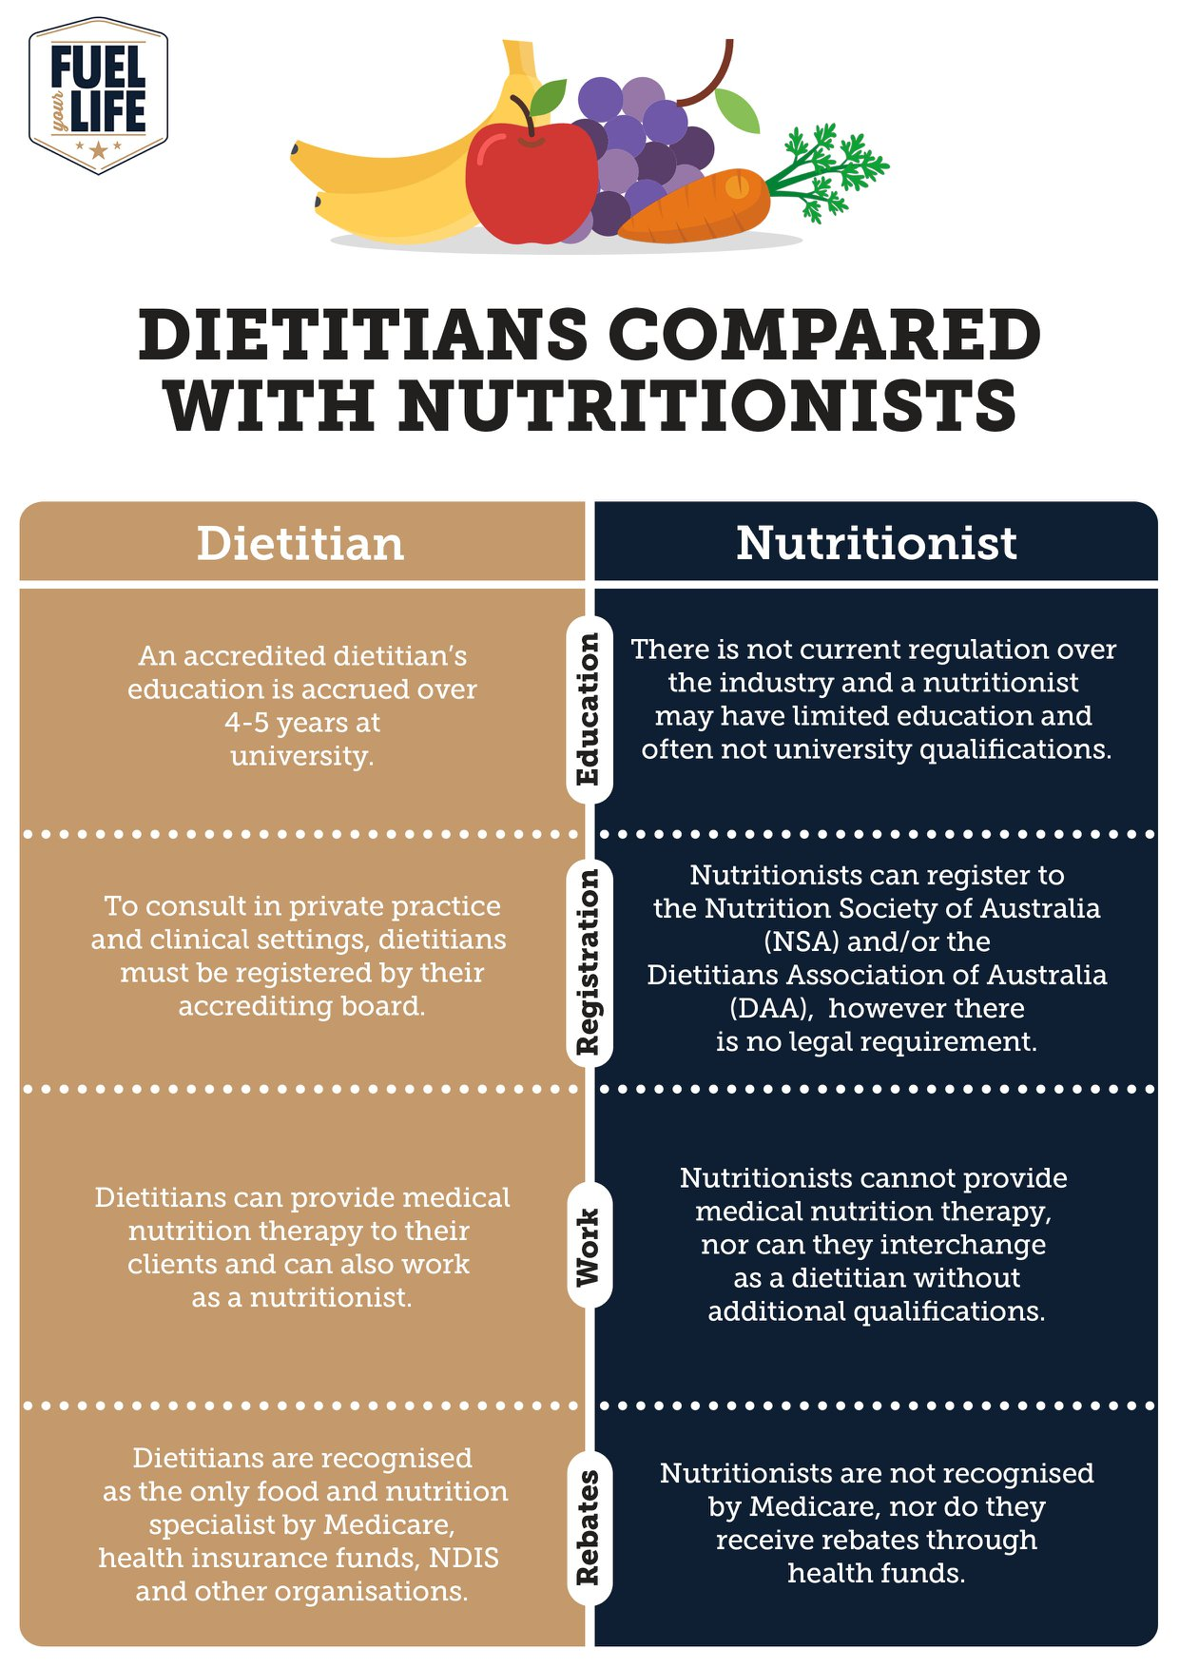

Slide 44
Dietitians In Practice
Clinical dietitians- Clinical dietitians work in hospitals, outpatient clinics, nursing care facilities and other health care facilities to provide nutrition therapy to patients with a variety of health conditions, and provide dietary consultations to patients and their families.
Community dietitians- Community dietitians work with wellness programs, public health agencies, home care agencies, and health maintenance organizations.
Food Service dietitians- Foodservice dietitians or managers are responsible for large-scale food planning and service. They coordinate, assess and plan food service processes in health care facilities, school food-service programs, prisons, restaurants, and company cafeterias.
Gerontological dietitians- Gerontological dietitians are specialists in nutrition and aging. They work in nursing homes, community-based aged care agencies, government agencies in aging policy, and in higher education in the field of gerontology (the study of aging)
Neonatal dietitians- Neonatal dietitians provide individualized medical nutrition therapy for critically ill premature newborns. They are considered a part of the Neonatal Intensive Care Unit's medical team.

Slide 45
Dietitians In Practice
Pediatric dietitians- Pediatric dietitians provide nutrition and health advice for infants, children, and adolescents. They focus on early nutritional needs, and often work closely with doctors, school health services, clinics, hospitals and government agencies.
Research dietitians- Research dietitians may focus on social sciences or health services research, for example, investigate the impact of health policies or behaviour change, or evaluate program effectiveness.
Administrative dietitians-Administrative or management dietitians oversee and direct all aspects of clinical dietetics service, food policy and/or large-scale meal service operations in hospitals, government agencies, company cafeterias, prisons, and schools. They recruit, train and supervise employees of dietetics departments including dietitians and other personnel.
Business dietitians- Business dietitians serve as resource people in food and nutrition through business, marketing and communications. Dietitians' expertise in nutrition is often solicited in the media.
Consultant dietitians- Consultant dietitians are those who are in private practice or practice on a contractual basis with health care facilities or corporations, such as used in Australia, Canada and the United States.

Slide 46
Role of Dietitian in Nutrition Care
The activities most likely to be undertaken by the clinical dietitians would include:
• Collecting, organizing and assessing data relating to health and nutritional status of
individuals, groups and communities,
• Review and analyze patients nutritional needs and goals to make appropriate dietary
recommendations,
• Develop and implement nutrition care plans and monitor, follow up and evaluate these plans
and take corrective measures wherever required,
• Calculate nutritional value of food/meals planned,
• Prescribe therapeutic diets and special nutrition support and feeding regimens,
• Oversee the preparation of special diets, special nutrition formulas for patients who are
critically or terminally and require special feeding through oral, enteral or parenteral routes,
• Plan and prepare basic menus and assist in supervising food service personnel in preparing
menus and serving of meals,
• Schedule work assignments in the dietary unit to facilitate the effective operation of the
kitchen and other food preparation or dining areas,
Dietitian you know is an expert in dietetics, dealing with human nutritional care. A dietitian apply the science and principals of human nutrition to help people understand the relationship between food and health and make appropriate dietary choices to attain and maintain health and to prevent and treat illness and disease.
Dietitians work in a wide variety of roles in, for example, a clinical, public health or community, food service, administrative, freelance/ consultancy, research or teaching capacity.
However, you will find that majority of dietitians are clinical dietitians working in hospitals, nursing homes and other health care facilities or specialized institutes/units to provide nutritional care to patients with a variety of health conditions, and provide dietary consultations to patients and their families.

Slide 47
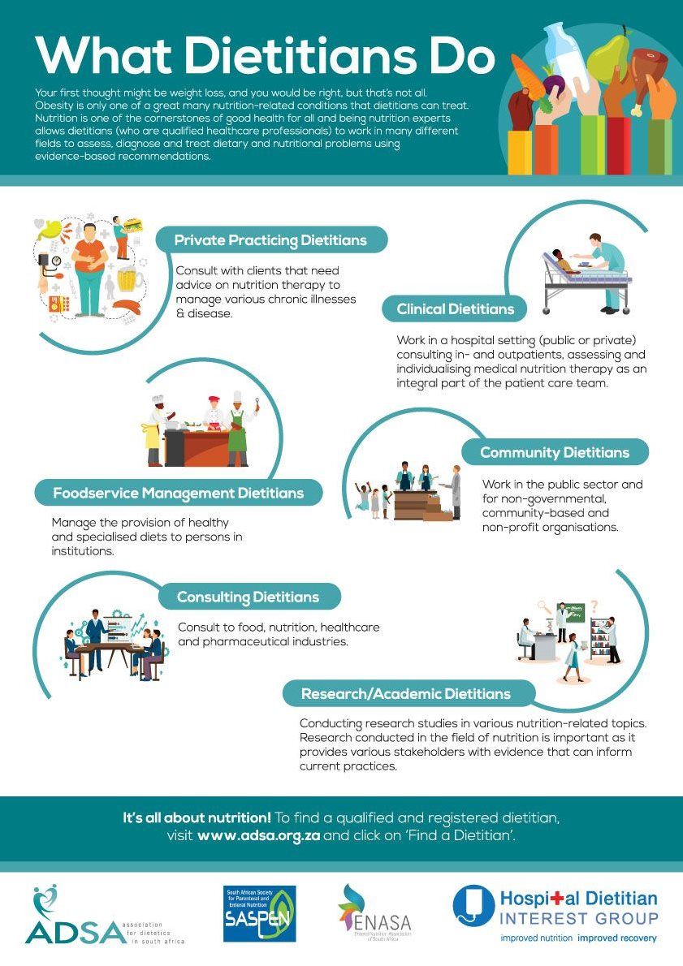

Slide 48
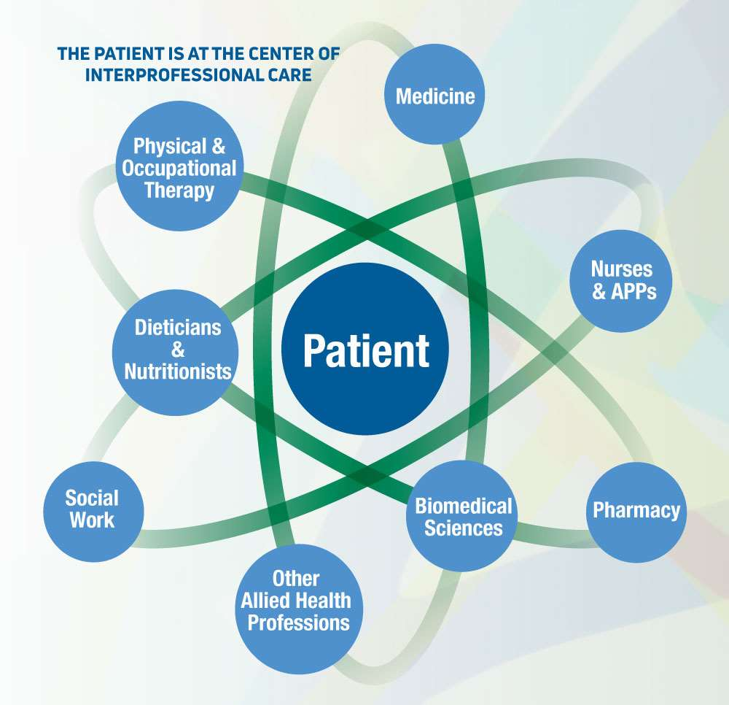

Slide 49
