Slide 1
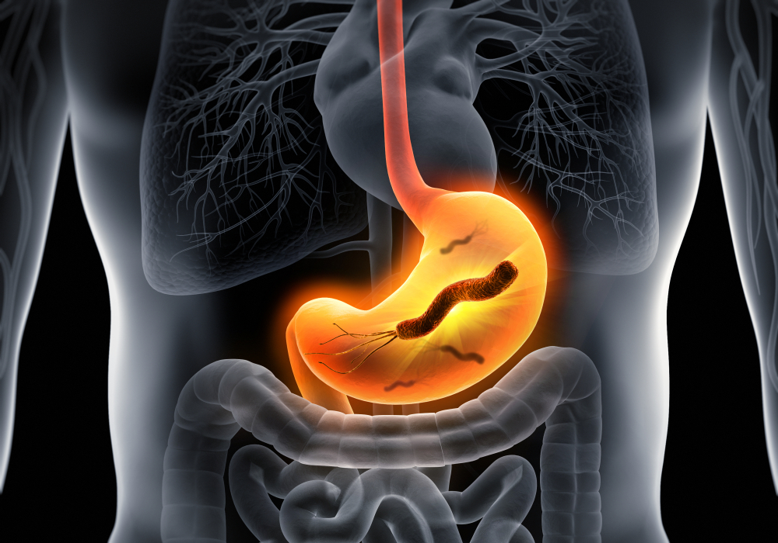
Ulcer By Helicobactor Pylori
Name: Prity Maity
Roll. No- 210340300045
Reg. No- 202101049853 of 2021-22
Course code- CC-12

Slide 2
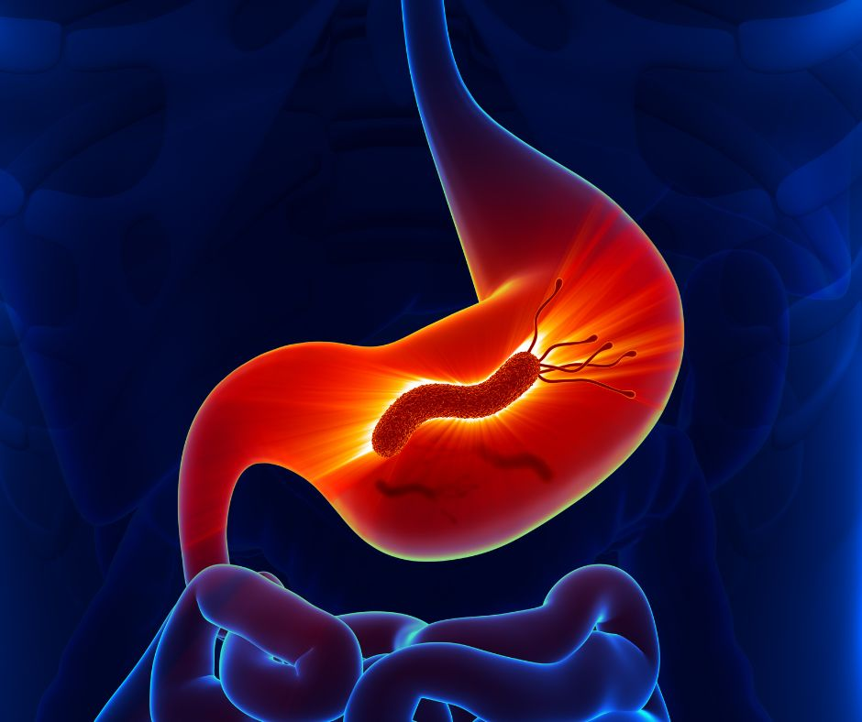
Introduction
Helicobactor Pylori is a type of bacteria that infects your stomach.
It attacks your stomach and the first part of your small intestine (duodenum).
Name of the pathogen : Helicobactor Pylori

Slide 3
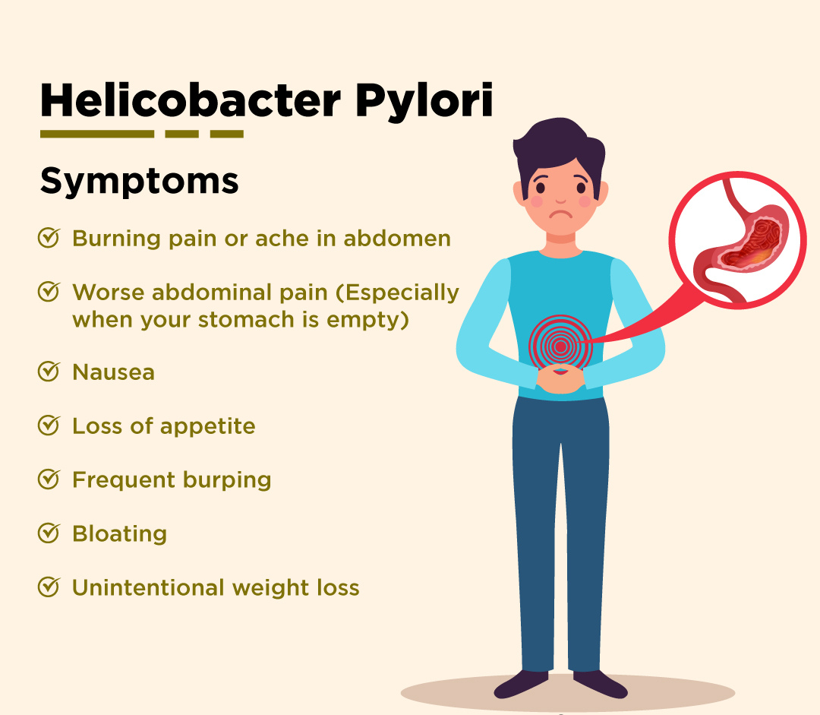
Symptoms :

Slide 4
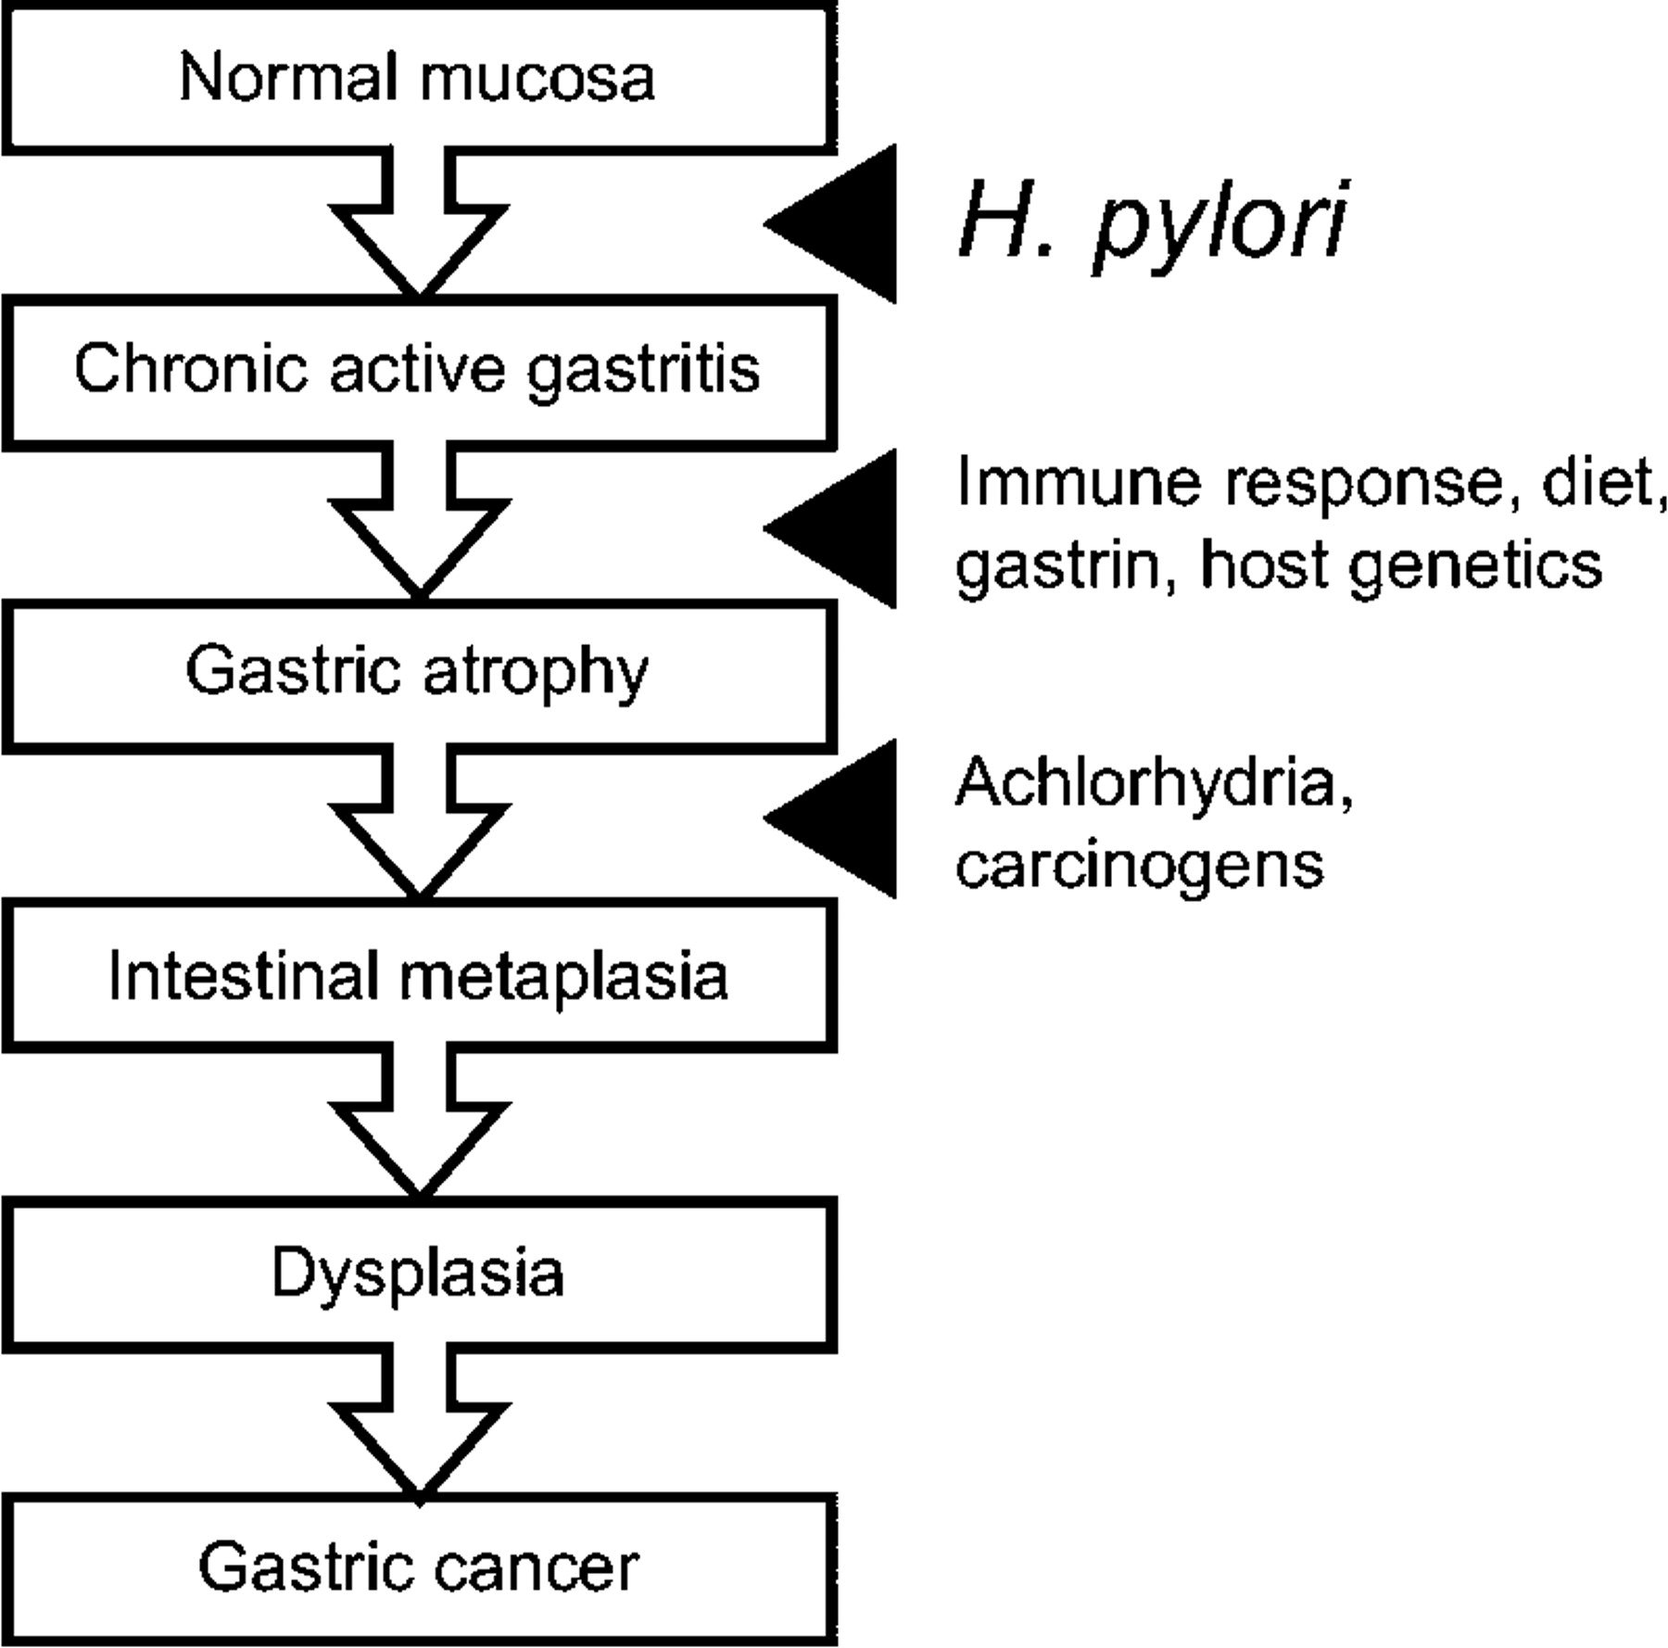
Pathogeneses

Slide 5
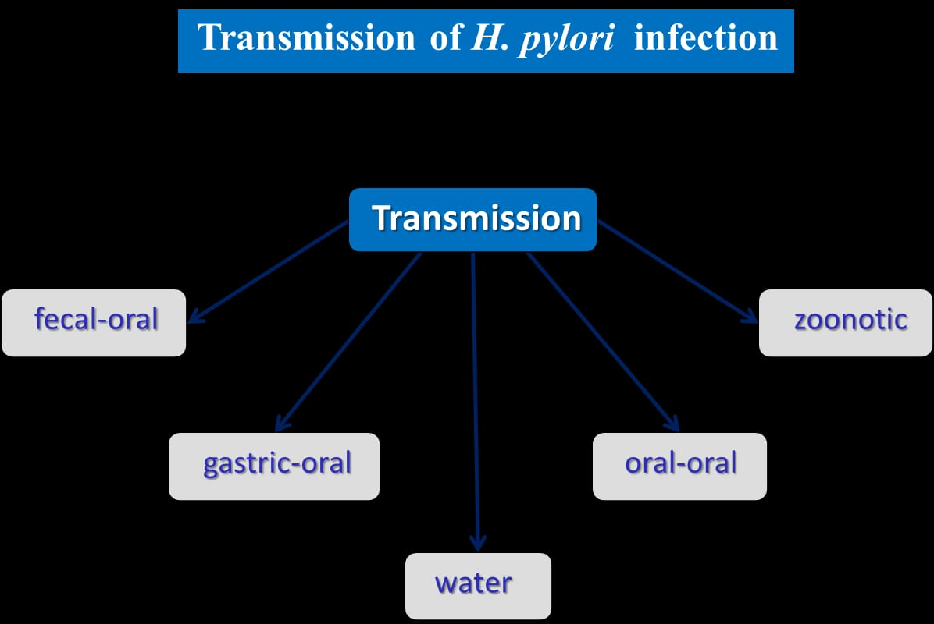
MODE OF ACTION

Slide 6
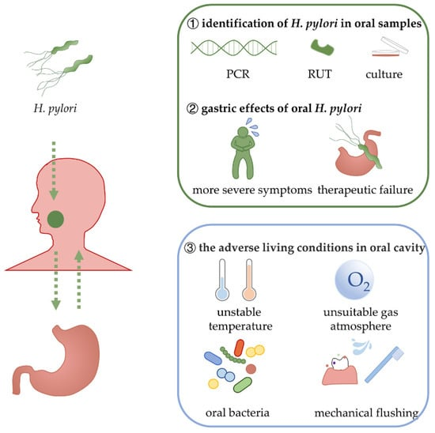
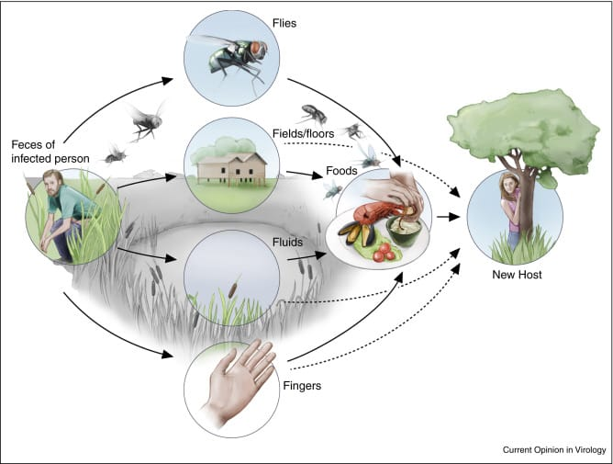
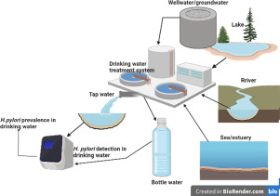
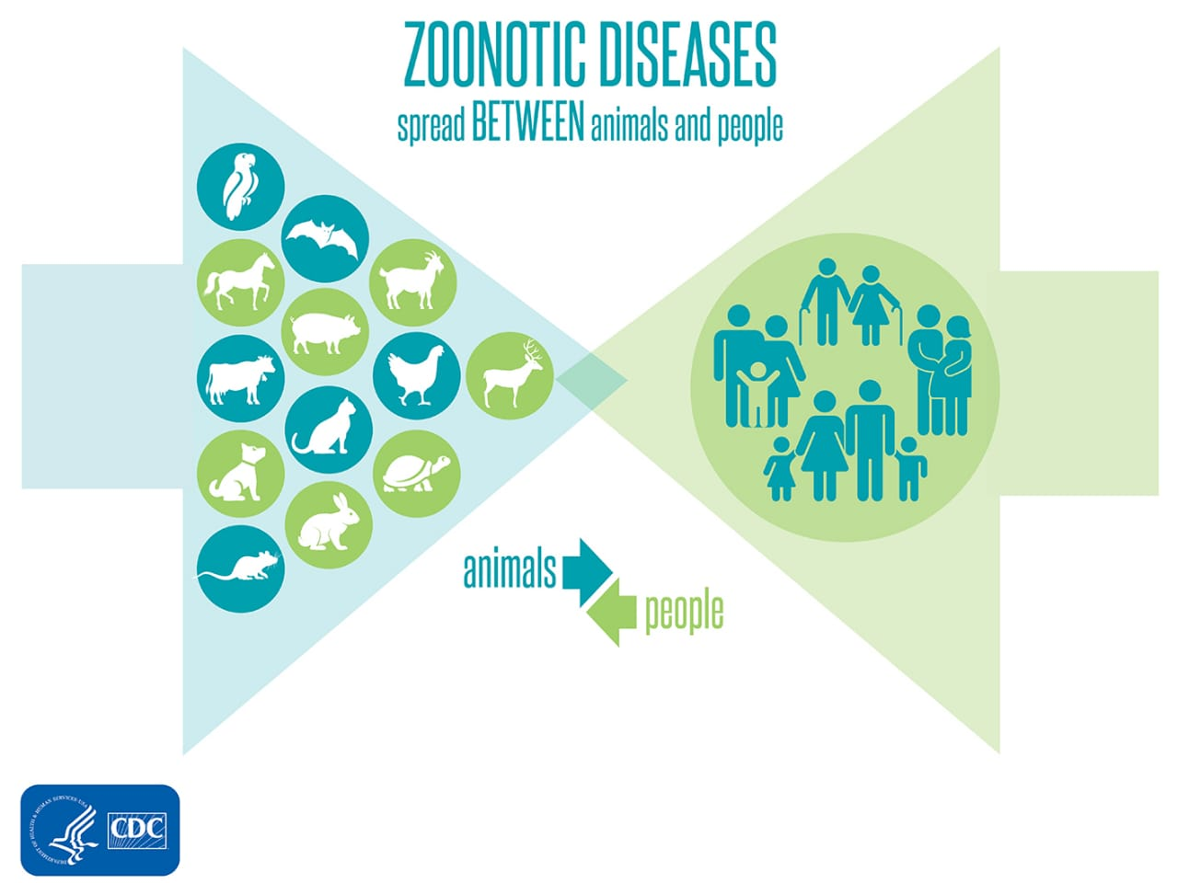
1. Fecal oral
2. Gastric oral
3.Water
4. Zoonotic

Slide 7
Preventive Measure
Practice good hygiene and hand washing, especially with food preparation.
All patient with chronic gastro intestinal symptoms that may be associated H.Pylori infection should be tested and treated to prevent exposure to family members.
Patient should complete full course of therapy (antibiotics and acid blockers) to maximize the potential for a cure.
Maintain proper nutrition to prevent iron deficiency anemia.
Increase vegetable intake (cauliflower, cabbage, broccoli).
Supposed policies to improve living conditions in developing countries.

Slide 8
Welcome

